Slide 1

Last Year’s Project Title:- Smart Water Management System
Group Number:- 7
Names :- Charmin Desai, Jigar Desai, Devanshi Trivedi
En.nos. :- 160410117005, 160410117011, 160410117061
Branch:- Instrumentation and Control
Class:- LY IC
Project Guide:- Prof. Janki N Chotai

Slide 2
INTRODUCTION
Title :- Smart Water Management System
Objective :-
- To save the water and to provide equal water distribution to each user and also calculate water usage by user. Thus determining the amount that amount to water bill.
- Prevention of water wastage in open taps using auto-close valve mechanism.
- To increase the monetary rate of water for a house, if the water usage is exceeded beyond the limits, followed by a message in phone for the same.
- Display of data on phone using GSM module based technology.
3) Scope :- Everywhere, Residential areas, Industry, etc.

Slide 3
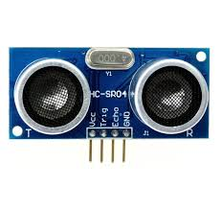

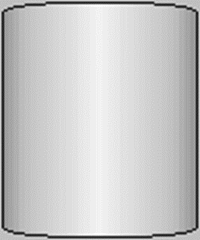


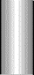
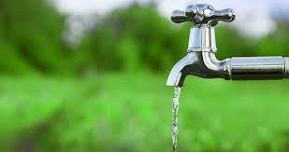

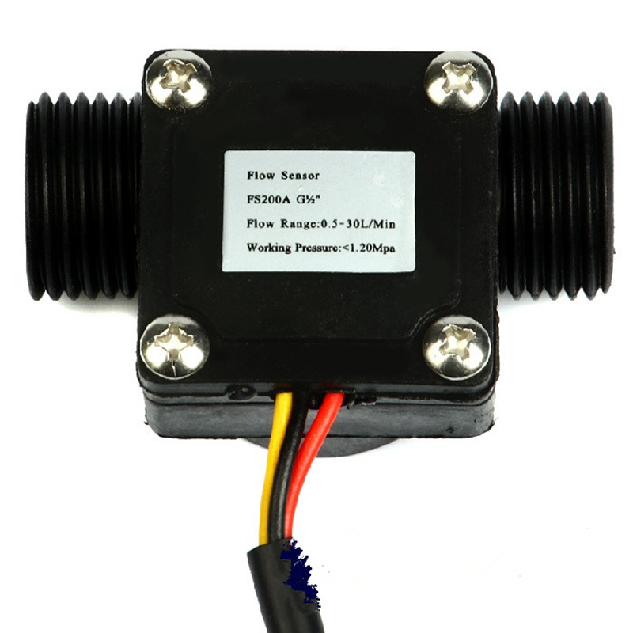






FLOW
SENSOR
LEVEL SENSOR
SOLENOID
VALVE
OVER-HEAD
TANK
HOUSE 1
S
CONTROL VALVE
LEVEL SENSOR
HOUSE 2
S
HOUSE 3
UNDER-GROUND
TANK
PUMP
S

Slide 4
LCD DISPLAY U1
GSM MODULE
ULTRASONIC SENSOR (O-H)
CONTROL
VALVE
O-H TANK
MCU / PLC
ARDUINO
(MCU) U1
RELAY U1
TAP U1
FLOW
SENSOR U1
SOLENOID
VALVE U1
RELAY 2
USER 1
(HUMAN)
ULTRASONIC SENSOR (U-G)
PUMP
FIG :- BLOCK DIAGRAM REPRESENTATION
U-G TANK

Slide 5
HARDWARE OVERVIEW
1) HARDWARE COMPONENTS
2) POWER SUPPLY
3) Solenoid Valve and Flow Sensor interfacing with
Embedded System ( Arduino Based )
4) Level Measurement and Embedded System ( Arduino Based )
5) Piping Hardware and Embedded System Integration

Slide 6
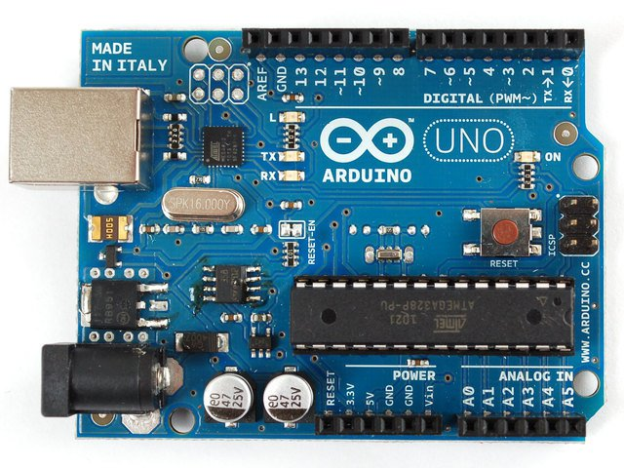
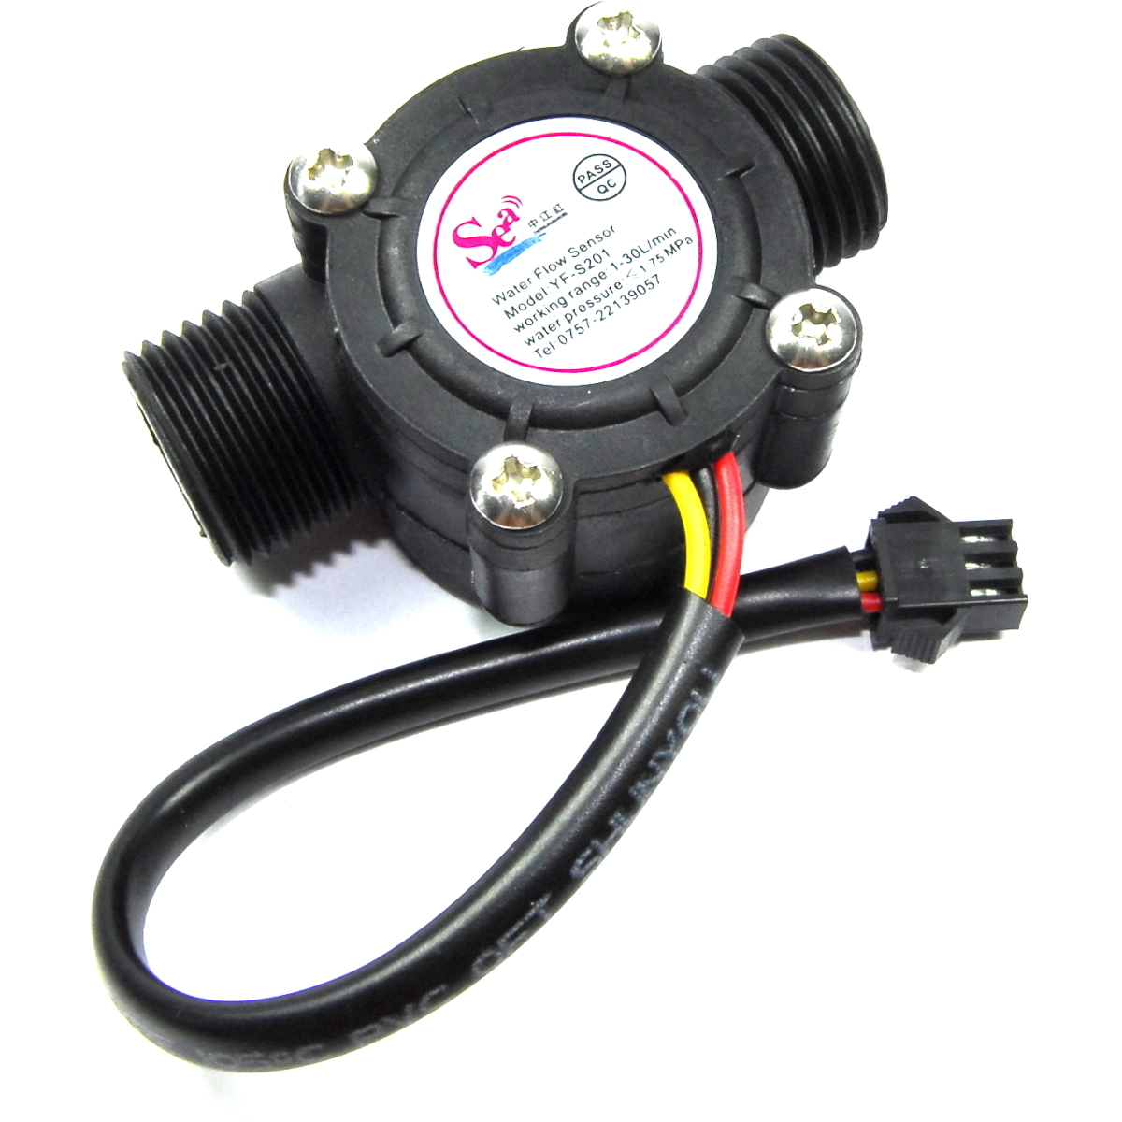
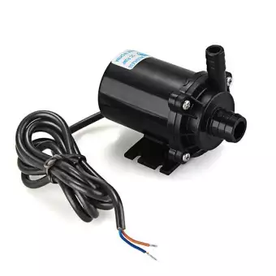

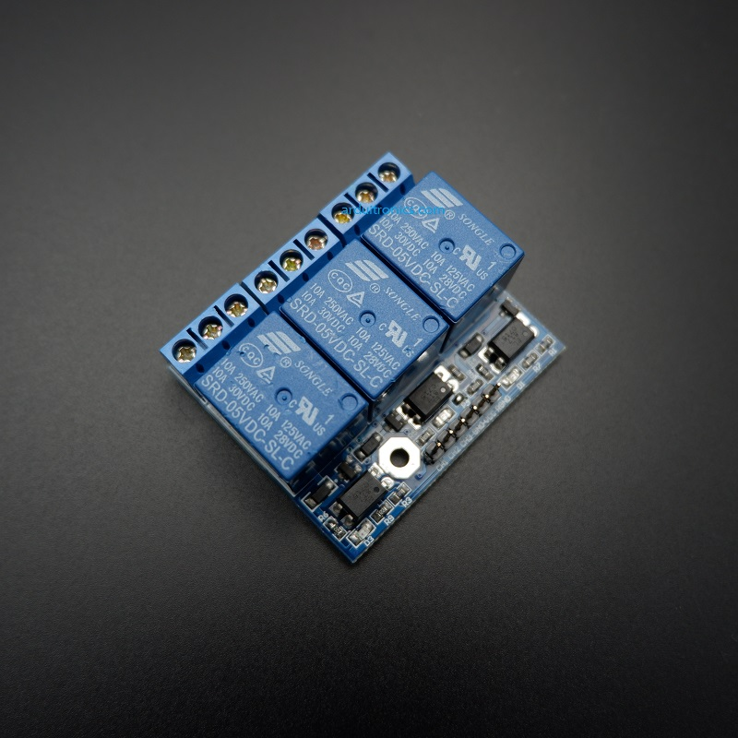
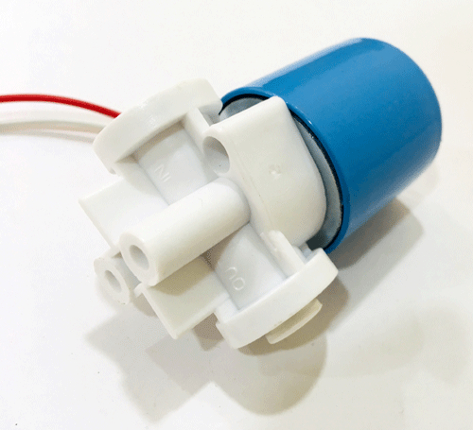
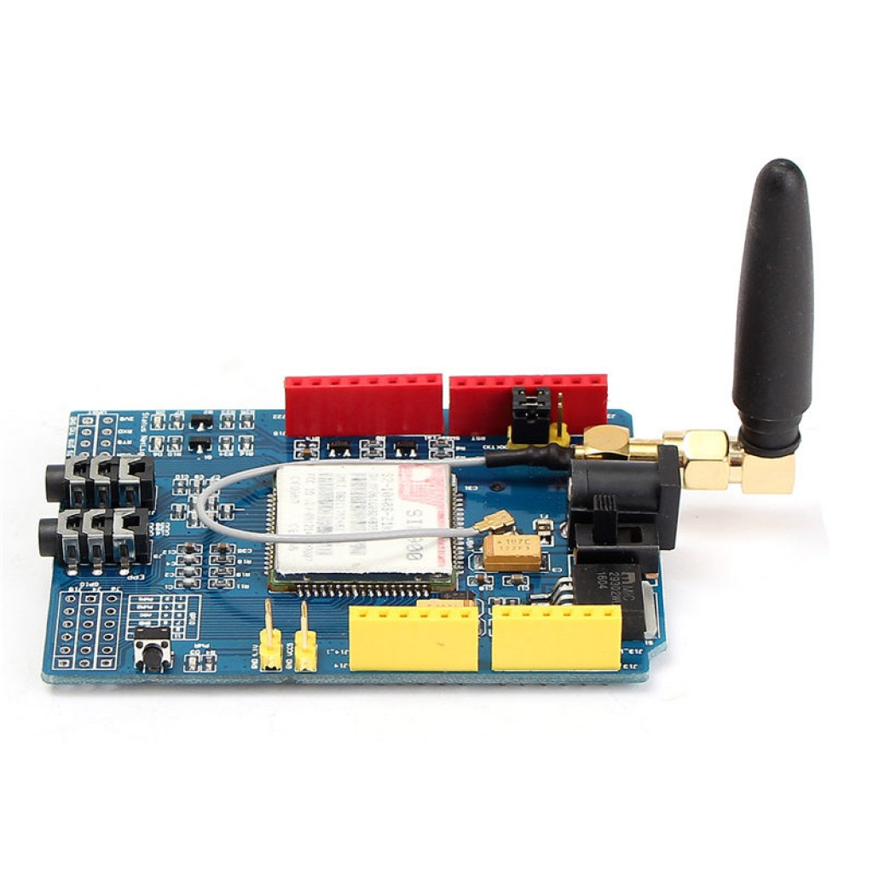
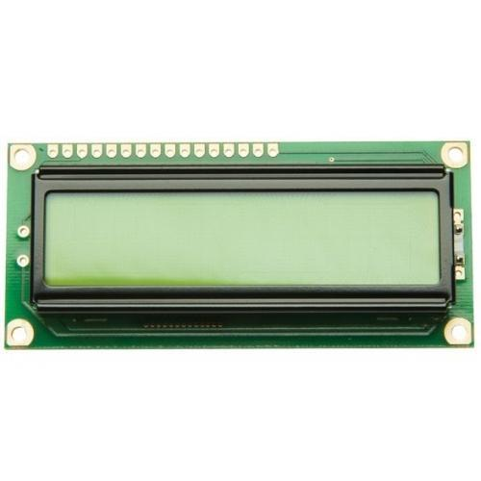
1) HARDWARE COMPONENTS
Arduino UNO
YF-S201
9-12V Pump
Ultrasonic Sensor
3-Channel Relay
Module
Solenoid Valve
16x2 LCD Display
GSM Module

Slide 7
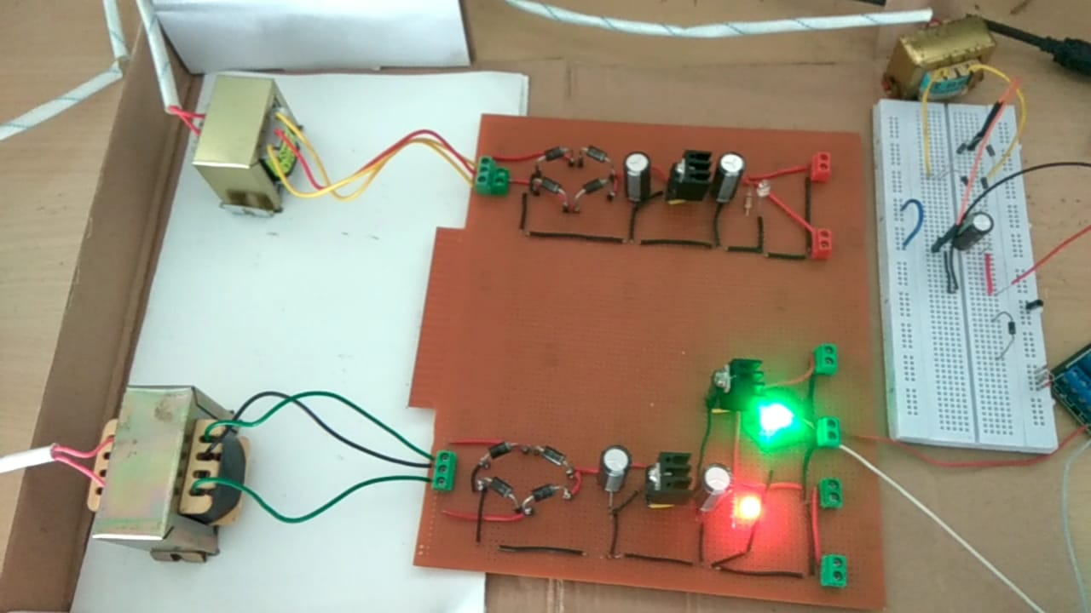
2) POWER SUPPLY

Slide 8
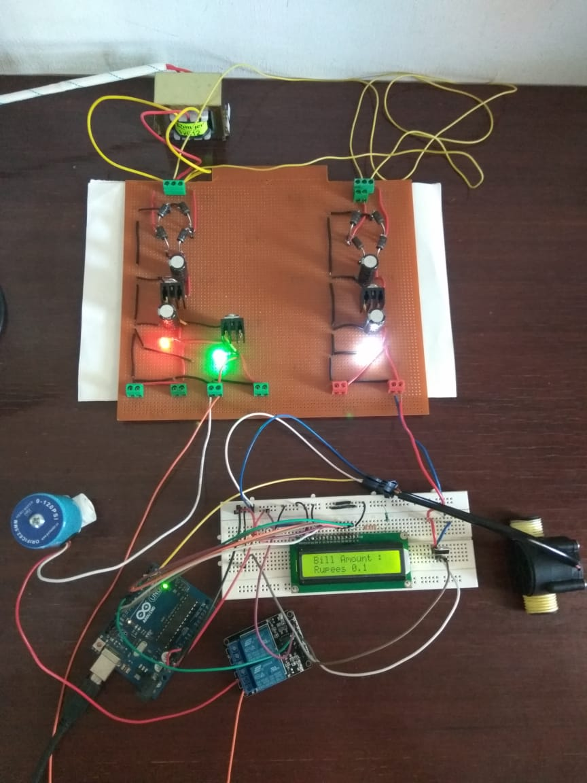
3) Solenoid Valve and Flow Sensor interfacing with
Embedded System ( Arduino Based )

Slide 9
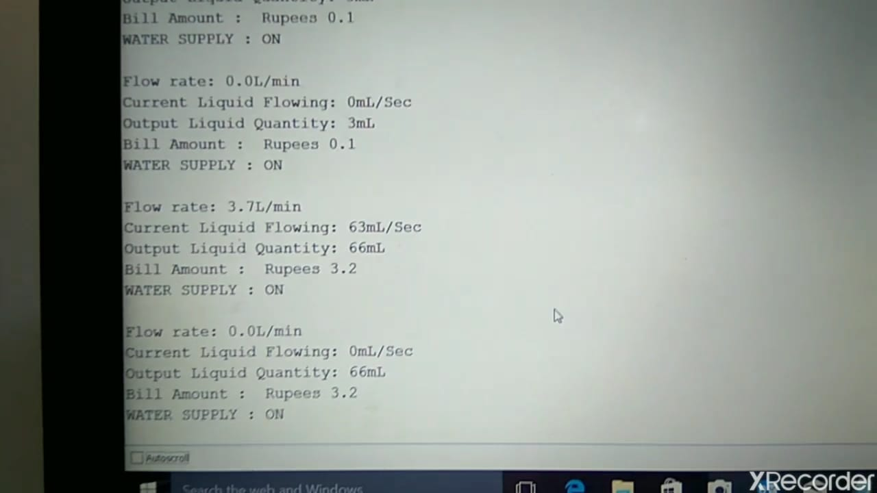
User and System Communication Interface

Slide 10
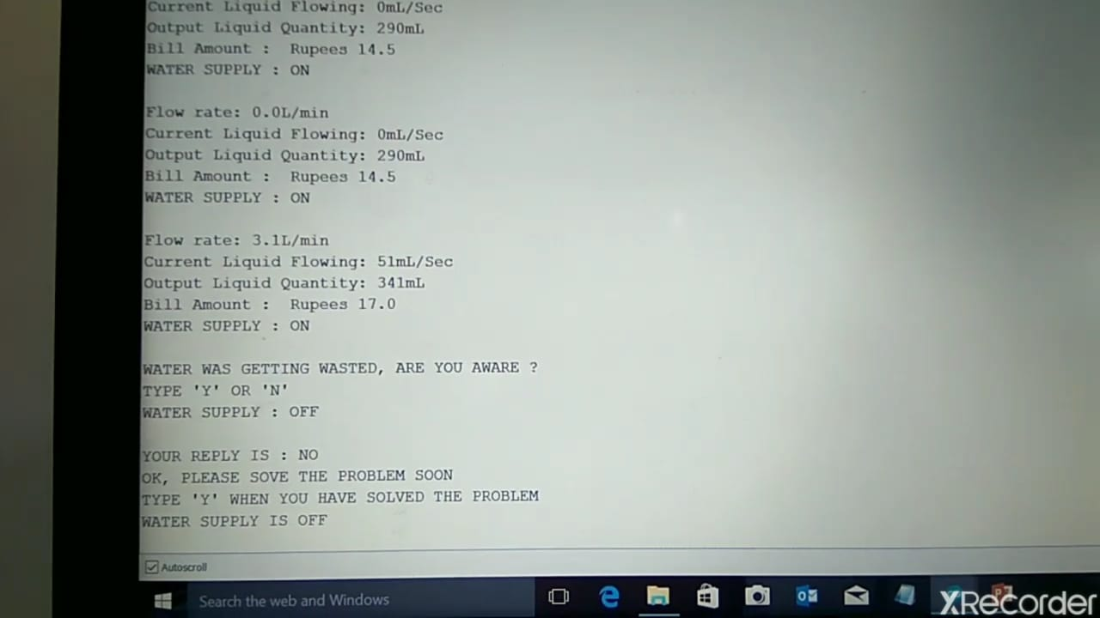
User and System Communication Interface

Slide 11
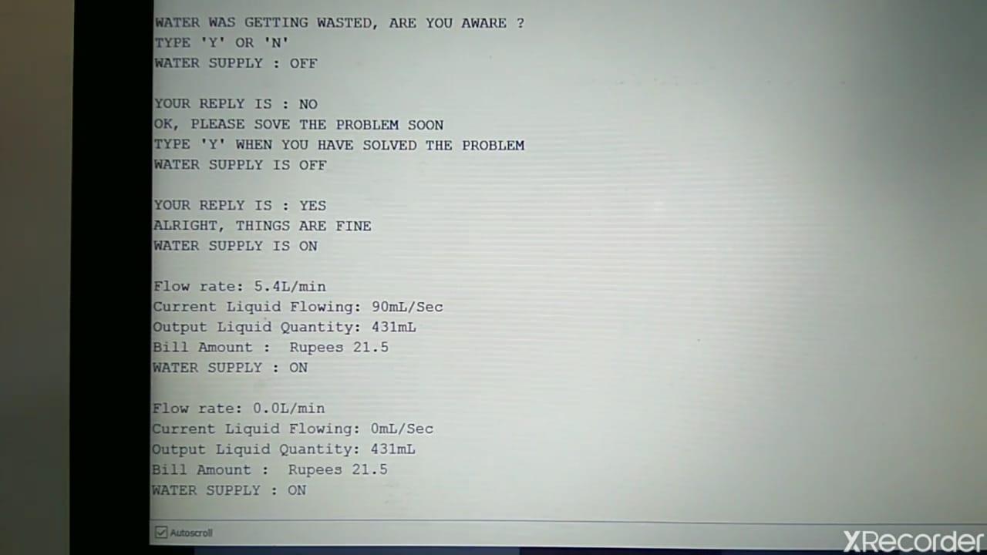
User and System Communication Interface

Slide 12
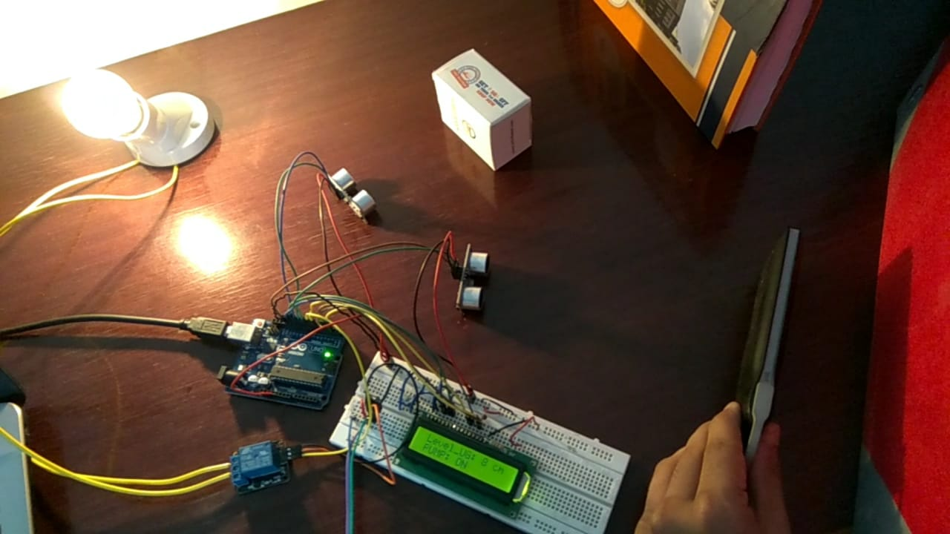
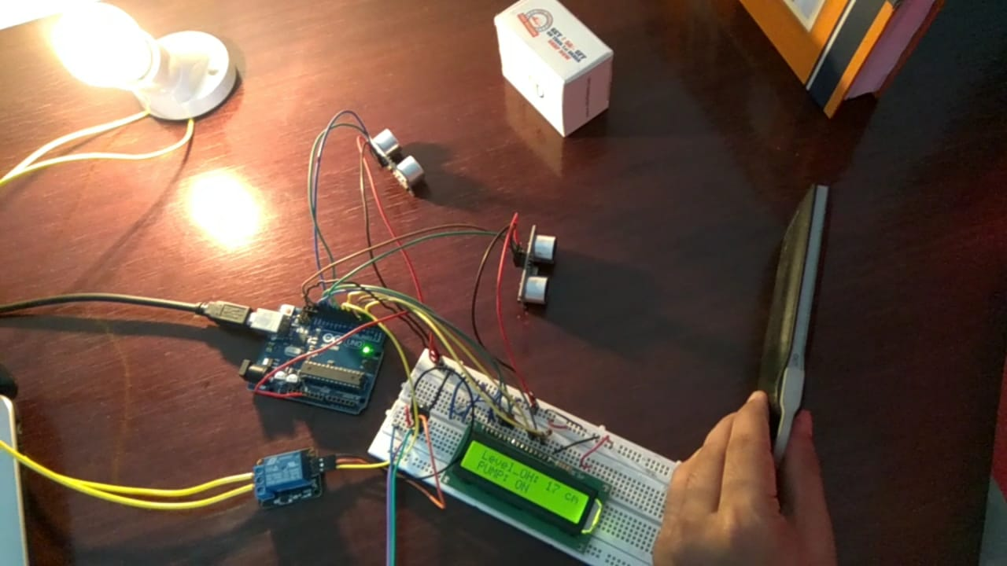
4) Level Measurement and Embedded System ( Arduino Based )
Note – The Electric Bulb is a substitute for the Electric Pump !

Slide 13
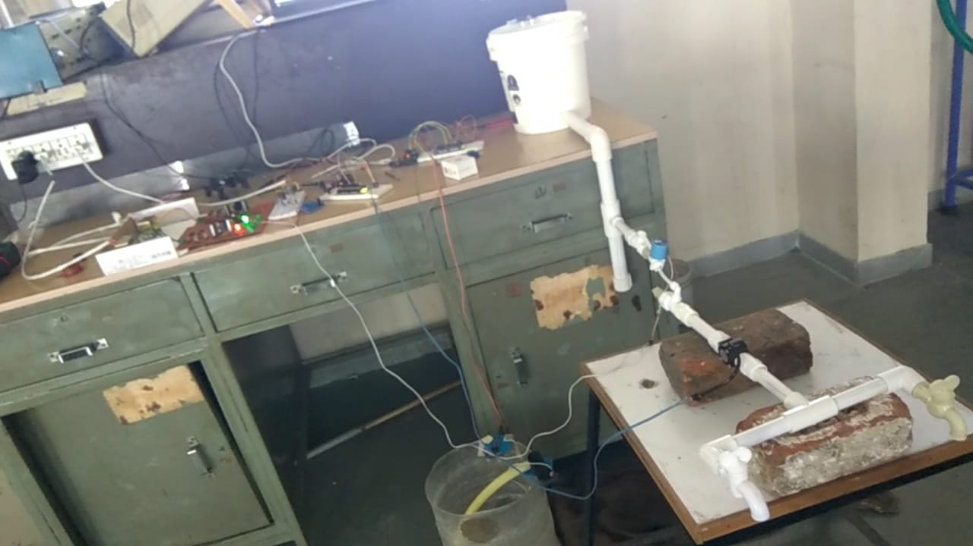
5) Piping Hardware and Embedded System Integration

Slide 14
STATUS OF HARDWARE AND COMPLETION
1. Status of the Hardwar is 100% in working condition.
2. The testing part is also completed, all sub-systems are working as per desire.
3. The part that is missing is the GSM based communication of the system with the user’s phone, it has not been done due
to the Covid-19 lockdown phase.
* The substitute for the same is ready and in working, that is, instead of the data to be shown on the user’s phone, now can be
now seen on the serial monitor of Arduino IDE and the controlling portion of it can also be done there. It has been tested and
it has worked as per the need.

Slide 15
CONCLUSION AND FUTURE SCOPE
Conclusion – We have given our best in successfully completing our project. This system will be used to calculate total water consumed by user. We will implement it in the main water line of house.
Through this meter we can collect the data of usage in order to save water and to reduce the wastage of water.
This system will be very helpful to governments for calculating the water usage and generate water bills. We can also provide optimum distribution of water to the users.
Future Scope – In future expansion, we think to work at each and every part to make it better. And to implement this technology into real life application for better living. We will also make this technology more cost effective and cheaper so that everyone can use this technology for accurate water usage and give more benefits to the people.
Moreover, this system can be designed/developed using a PLC and can be made to operate by software (LABVIEW). The use of LABVIEW software can be useful in the industry to monitor and control.

Slide 16
VIDEO LINK OF THE WORKING PROJECT
1) https://drive.google.com/file/d/1j8p6WFNxbbWADe1bazo6hsqflzkawm0I/view?usp=drivesdk
2)
https://drive.google.com/file/d/1k5RXA50WYCAYCfZI_T9t9TcUA3HXvV2d/view?usp=drivesdk
3)
https://drive.google.com/file/d/1lEOq4SDRH9o32vxWeRMBOAD_YnOe3P9h/view?usp=drivesdk
4)
https://drive.google.com/file/d/11bcZOQLJs69aSBYNs8D3wAMPT0YHTRb7/view?usp=sharing

Slide 17
THANK YOU

